Slide 1
2020 OHDSI Symposium Tutorial Treatment Regimen Episodes and Detection Algorithm

Slide 2
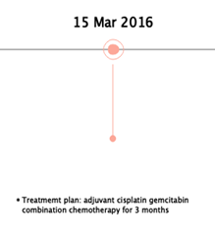
Chemotherapy
Adjuvant = after surgery
Cisplatin = drug
Gemcitabine = drug
Combination for 3 months = regimen

Slide 3
Chemotherapy
Regimen
Cisplatin + Gemcitabine

Slide 4
Chemotherapy
Regimen
Cisplatin + Gemcitabine
1 month
1 month
1 month
Cycle 1
Cisplatin + Gemcitabine
Cycle 2
Cisplatin + Gemcitabine
Cycle 3
Cisplatin + Gemcitabine

Slide 5
Chemotherapy
Regimen
Cisplatin + Gemcitabine
1 month
1 month
1 month
Cycle 1
Cisplatin + Gemcitabine
Cycle 2
Cisplatin + Gemcitabine
Cycle 3
Cisplatin + Gemcitabine
Day 1
C
Day 1
Day 8
Day 15
G
G
G

Slide 6
Chemotherapy
Regimen
Cisplatin + Gemcitabine
1 month
1 month
1 month
Cycle 1
Cisplatin + Gemcitabine
Cycle 2
Cisplatin + Gemcitabine
Cycle 3
Cisplatin + Gemcitabine
Day 1
C
70 mg/m² body surface area
Day 1
Day 8
Day 15
G
G
G
1000 mg/m² body surface area

Slide 7
Chemotherapy
Regimen
Cisplatin + Gemcitabine
1 month
1 month
1 month
Cycle 1
Cisplatin + Gemcitabine
Cycle 2
Cisplatin + Gemcitabine
Cycle 3
Cisplatin + Gemcitabine
Day 1
C
70 mg/m²
100 mg/m²
Day 1
Day 8
Day 15
G
G
G
1000 mg/m²
1250 mg/m²

Slide 8
Chemotherapy
Regimen
Cisplatin + Gemcitabine
1 month
1 month
1 month
Cycle 1
Cisplatin + Gemcitabine
Cycle 2
Cisplatin + Gemcitabine
Cycle 3
Cisplatin + Gemcitabine
Day 1
Day 1
Day 1
C
C
C
Day 1
Day 8
Day 15
Day 1
Day 8
Day 15
Day 1
Day 8
Day 15
G
G
G
G
G
G
G
G
G

Slide 9
Why this complexity?
Maximize antineoplastic effect
Minimize effect on healthy cells
Cycles
Combinations
Precise dosing
Precise timing
1 month
Cycle 1
Cisplatin + Gemcitabine
Day 1
C
70 mg/m²
100 mg/m²
Day 1
Day 8
Day 15
G
G
G
1000 mg/m²
1250 mg/m²

Slide 10

Vocabulary Representation
concept_id | concept_name | concept_class_id
35803575 | Cisplatin and Gemcitabine | Regimen
35802958 | Cisplatin | Component
SIG
Regimen
Cisplatin + Gemcitabine
C
Day 1
Day 8
Day 15
70 mg/m²
100 mg/m²

Slide 11
Structure
Regimen
Cisplatin + Gemcitabine
Has antineoplastic
Component
Cisplatin
Component
Gemcitabine
Maps to
Maps to
RxNorm Ingredient
cisplatin
RxNorm Ingredient
gemcitabine

Slide 12
Structure
Condition
Pancreatic Cancer
Maps to
Condition
Cervical Cancer
SNOMED Condition
Carcinoma of Bladder
Condition
Bladder Cancer
Has accepted use
Regimen
Cisplatin + Gemcitabine
Has antineoplastic
Component
Cisplatin
Component
Gemcitabine
Maps to
Maps to
RxNorm Ingredient
cisplatin
RxNorm Ingredient
gemcitabine

Slide 13
Structure
Condition
Pancreatic Cancer
Maps to
Maps to
Component Class
Phenothiazines
Condition
Cervical Cancer
SNOMED Condition
Carcinoma of Bladder
Has supportive med
Condition
Bladder Cancer
Component
Dexamethasone
Has accepted use
Regimen
Cisplatin + Gemcitabine
Has antineoplastic
Component
Cisplatin
Component
Gemcitabine
Maps to
Maps to
RxNorm Ingredient
cisplatin
RxNorm Ingredient
gemcitabine

Slide 14
Use Cases
What lines of chemotherapy?
How many cycles of C+G?
What toxicity did the patient experience?
Epirubicin
Cisplatin and Gemcitabine
Durvalumab
3
Diarrhea
Regimen
Cycle 1
C
C
C
C

Slide 15
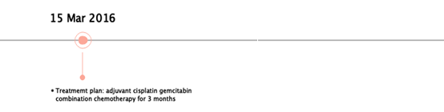
Drug Exposure and Treatment Episodes
Regimen
EPISODE
Cycle 1
Cycle 2
Cycle 3
DRUG_EXPOSURE

Slide 16
Drug Exposure and Treatment Episodes
EPISODE
DRUG_EXPOSURE
C
C
C
G
G
G
G
G
G
G
G
G

Slide 17
Drug Exposure and Treatment Episodes
Regimen
EPISODE
Cycle 1
Cycle 2
Cycle 3
Regimen
Detection
Algorithm
DRUG_EXPOSURE
C
C
C
G
G
G
G
G
G
G
G
G

Slide 18
OMOP Data Science Team contribution Oncology Regimen Algorithm
“Theano”

Slide 19

Package Structure
OHDSI gold standard for packages
Version 1 of the package was implemented by using the OHDSI gold standard for packages.
This ensures that the algorithm is:
Simple
Readable
Consistent with other OHDSI packages
Testable

Slide 20
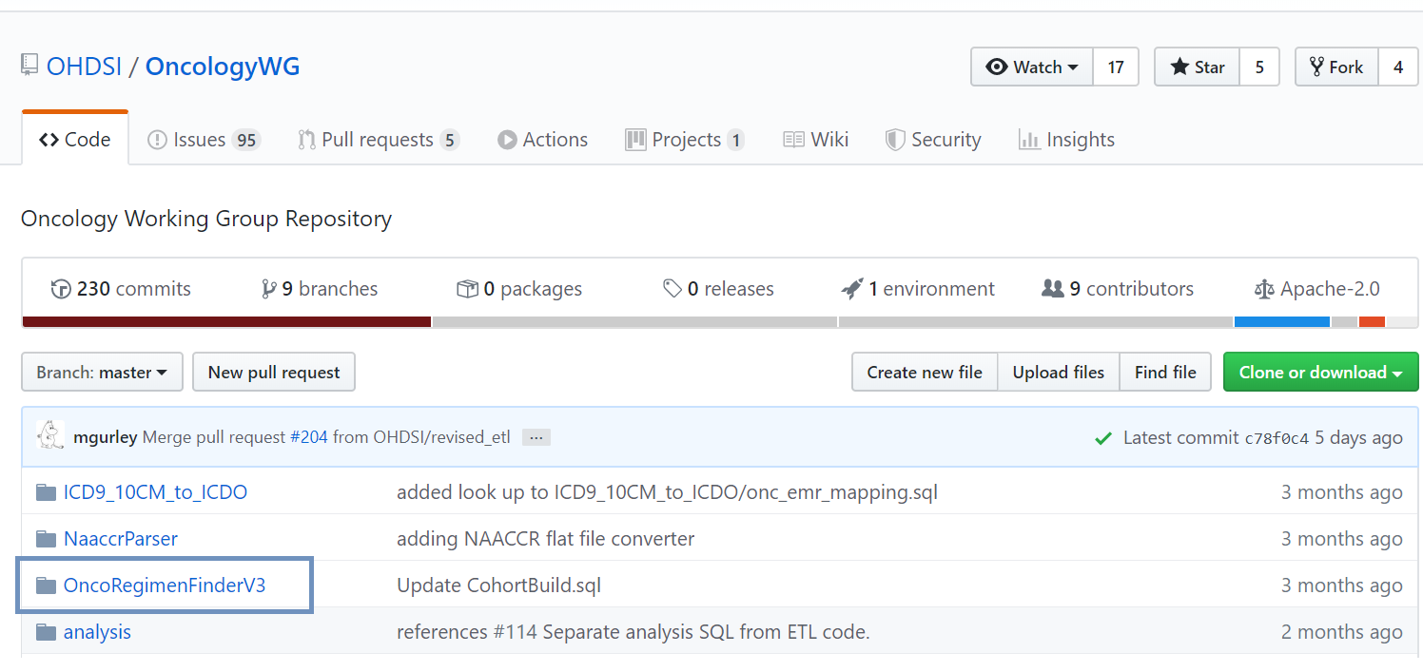
Package Structure
OHDSI gold standard for packages
Version 1 of the package was implemented by using the OHDSI gold standard for packages.
This ensures that the algorithm is:
Simple
Readable
Consistent with other OHDSI packages
Testable

Slide 21
Algorithm – Rule based approach

Slide 22
Algorithm - Procedure
Identify all the “Antineoplastic agents”
and the “Immunosapresants” through the drug_era table

Slide 23
Algorithm - Procedure
Identify all the “Antineoplastic agents”
and the “Immunosapresants” through the drug_era table
The results are ordered by date

Slide 24
Algorithm - Procedure
Identify all the “Antineoplastic agents”
and the “Immunosapresants” through the drug_era table
The results are ordered by date
Ingredients with consequent eras and start dates that occur within a 30 days period are identified

Slide 25
Algorithm - Procedure
Identify all the “Antineoplastic agents”
and the “Immunosapresants” through the drug_era table
The results are ordered by date
Ingredients with consequent eras and start dates that occur within a 30 days period are identified
Lines of treatments with distinct ingredients are generated

Slide 26
Algorithm - Procedure
Identify all the “Antineoplastic agents”
and the “Immunosapresants” through the drug_era table
The results are ordered by date
Ingredients with consequent eras and start dates that occur within a 30 days period are identified
Lines of treatments with distinct ingredients are generated
HemOnc vocabulary is used to identify oncology regimens

Slide 27
Algorithm - Procedure
Identify all the “Antineoplastic agents”
and the “Immunosapresants” through the drug_era/drug_exposure table
The results are ordered by date
Ingredients with consequent eras and start dates that occur within a 30 days period are identified
Oncology regimens stored in the episode and episode event tables
Lines of treatments with distinct ingredients are generated
HemOnc vocabulary is used to identify oncology regimens

Slide 28

HemOnc and Solving Granularity

Slide 29
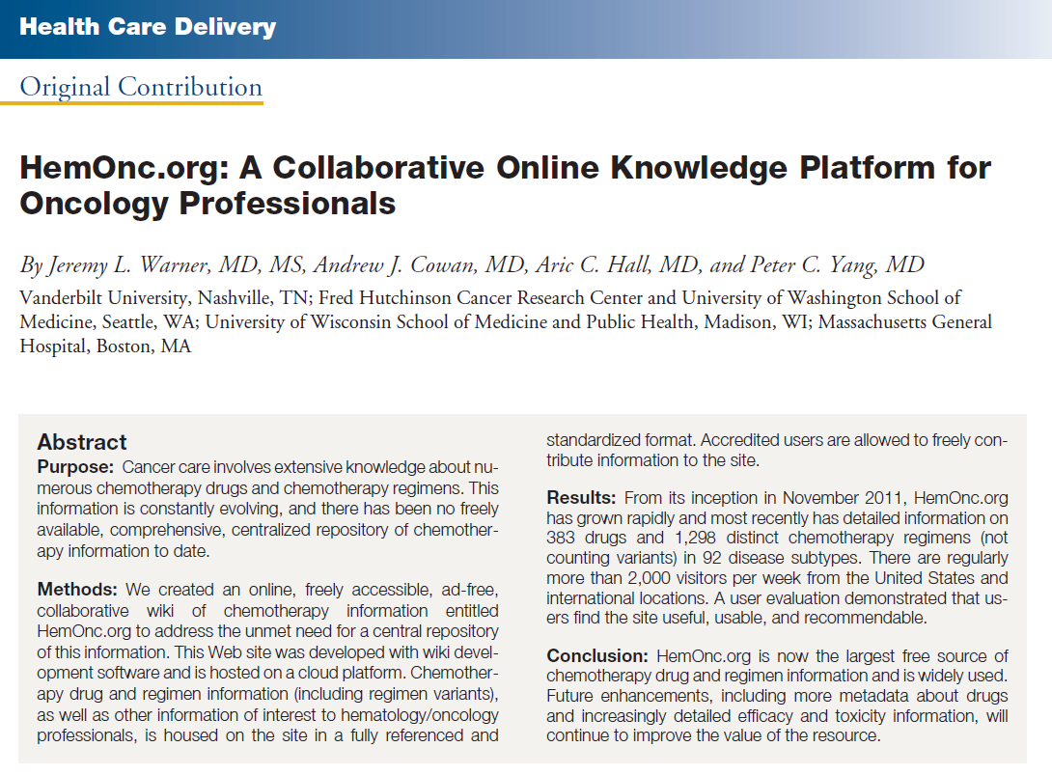
HemOnc.org
HemOnc.org is a collaborative wiki containing details about hundreds of hematology/oncology drugs, and thousands of treatment regimens.
Content is added by hematology & oncology professionals, and undergoes continuous peer review.
The OHDSI Oncology WG is an active contributor.
Led by Jeremy Warner and his team at Vanderbilt University.

Slide 30
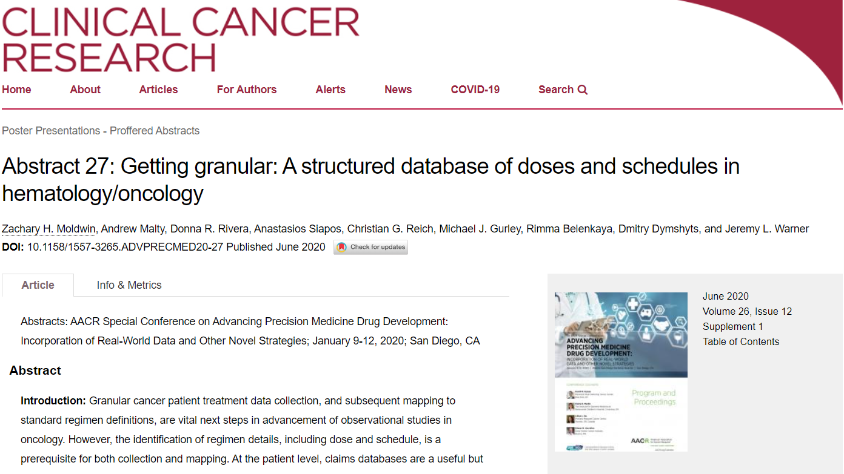
HemOnc.org
Provides:
Standard regimen definitions.

Slide 31
HemOnc.org
Provides:
Standard regimen definitions.
Comprehensive regimen details, including dosage and schedule.

Slide 32
HemOnc.org
Provides:
Standard regimen definitions.
Comprehensive regimen details, including dose and schedule.
Standardization of prescribing instructions within a given cycle (SIGs) or pertaining to cycle timing (“cycleSIGs”).

Slide 33
HemOnc.org
Provides:
Standard regimen definitions.
Comprehensive regimen details, including dose and schedule.
Standardization of prescribing instructions within a given cycle (SIGs) or pertaining to cycle timing (“cycleSIGs”).
Standard “canonical” forms for intermittent intravenous (IV), continuous IV (CIV), other routes (e.g., oral), and radiation SIGs.

Slide 34
HemOnc.org
Provides:
Standard regimen definitions.
Comprehensive regimen details, including dose and schedule.
Standardization of prescribing instructions within a given cycle (SIGs) or pertaining to cycle timing (“cycleSIGs”).
Standard “canonical” forms for intermittent intravenous (IV), continuous IV (CIV), other routes (e.g., oral), and radiation SIGs.
SIGs bound to regimen and treatment context.

Slide 35
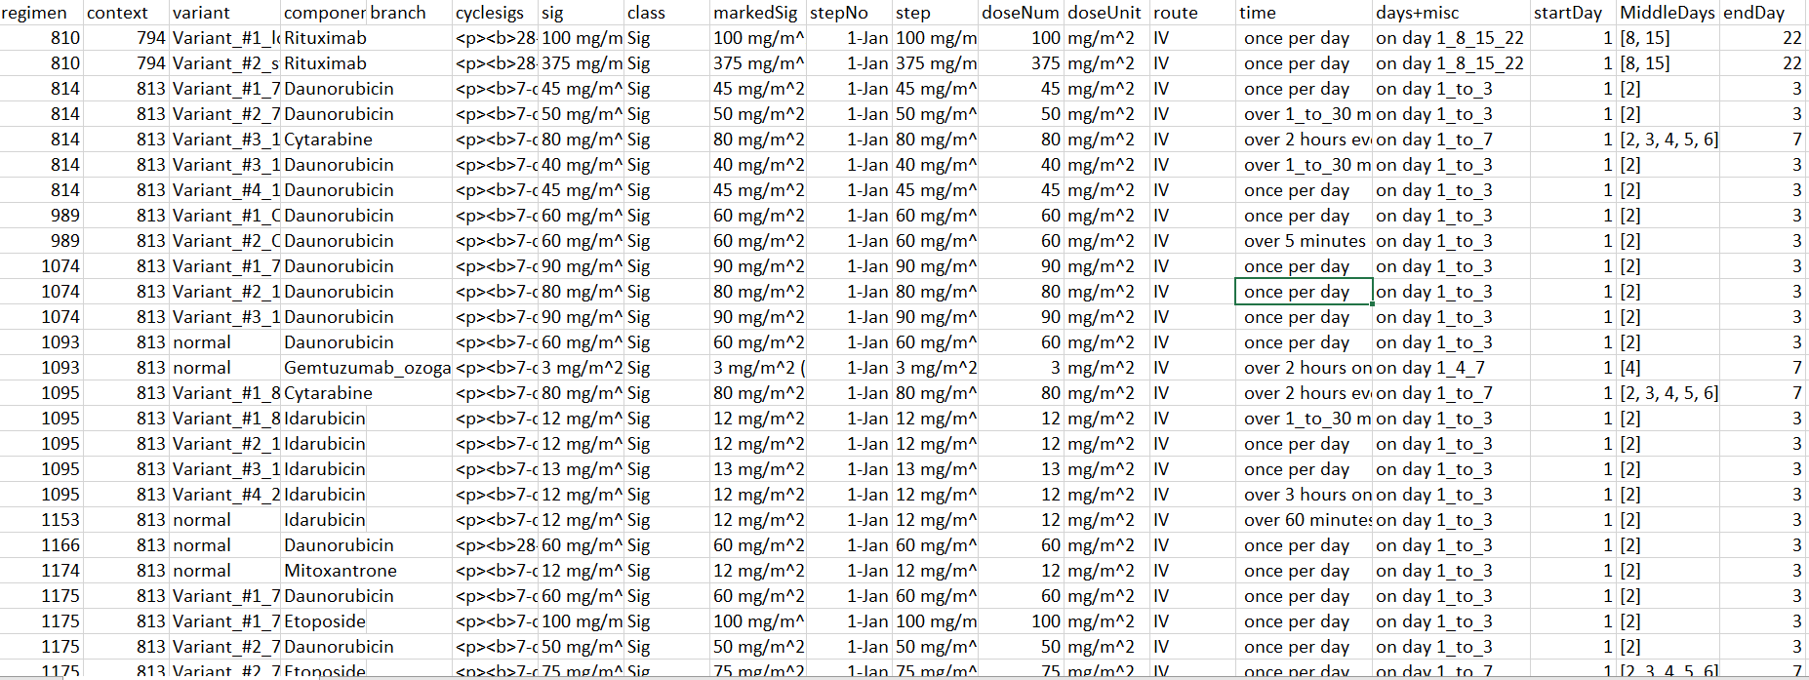
HemOnc.org
Sig = 100 mg/m^2 IV once per day on days 1, 8, 15, 22

Slide 36
Examples

Slide 37
Examples
Data for person_id = 1692
Input:
Output
Step 1
concept_name | drug_exposure_id | person_id | drug_concept_id | start_date
etoposide | 38969543 | 1692 | 19077215 | 12/7/2016
etoposide | 27876058 | 1692 | 40041386 | 12/7/2016
carboplatin | 27876060 | 1692 | 40022178 | 12/7/2016
etoposide | 8542664 | 1692 | 40041386 | 12/8/2016
etoposide | 37216873 | 1692 | 40041386 | 12/9/2016
etoposide | 6157373 | 1692 | 40041386 | 12/28/2016
carboplatin | 6157375 | 1692 | 40022178 | 12/28/2016
etoposide | 20227519 | 1692 | 40041386 | 12/29/2016
etoposide | 8609989 | 1692 | 40041386 | 12/30/2016
etoposide | 15655753 | 1692 | 40041386 | 1/18/2017
carboplatin | 15655755 | 1692 | 40022178 | 1/18/2017
etoposide | 4508082 | 1692 | 40041386 | 1/19/2017
etoposide | 11422068 | 1692 | 40041386 | 1/20/2017
etoposide | 24900262 | 1692 | 40041386 | 2/8/2017
carboplatin | 24900264 | 1692 | 40022178 | 2/8/2017
etoposide | 23719345 | 1692 | 40041386 | 2/9/2017
etoposide | 13787826 | 1692 | 40041386 | 2/10/2017
pembrolizumab | 34940090 | 1692 | 46276411 | 6/21/2017
pembrolizumab | 9194796 | 1692 | 46276411 | 7/12/2017
pembrolizumab | 37177882 | 1692 | 46276411 | 8/2/2017
pembrolizumab | 4515657 | 1692 | 46276411 | 8/23/2017
person_id | regimen_start_date | ingredient | concept_id | Regimen name
1692 | 12/7/2016 | carboplatin | 35806400 | Carboplatin and Etoposide
1692 | 12/7/2016 | etoposide | 35806400 | Carboplatin and Etoposide
1692 | 6/21/2017 | pembrolizumab | 35803678 | Pembrolizumab monotherapy
person_id | regimen_start_date | concept_id | Regimen name
1692 | 12/7/2016 | 35806400 | Carboplatin and Etoposide
1692 | 6/21/2017 | 35803678 | Pembrolizumab monotherapy

Slide 38
Examples
Data for person_id = 1692
Input:
Output
Step 1
Step 2
concept_name | drug_exposure_id | person_id | drug_concept_id | start_date
etoposide | 38969543 | 1692 | 19077215 | 12/7/2016
etoposide | 27876058 | 1692 | 40041386 | 12/7/2016
carboplatin | 27876060 | 1692 | 40022178 | 12/7/2016
etoposide | 8542664 | 1692 | 40041386 | 12/8/2016
etoposide | 37216873 | 1692 | 40041386 | 12/9/2016
etoposide | 6157373 | 1692 | 40041386 | 12/28/2016
carboplatin | 6157375 | 1692 | 40022178 | 12/28/2016
etoposide | 20227519 | 1692 | 40041386 | 12/29/2016
etoposide | 8609989 | 1692 | 40041386 | 12/30/2016
etoposide | 15655753 | 1692 | 40041386 | 1/18/2017
carboplatin | 15655755 | 1692 | 40022178 | 1/18/2017
etoposide | 4508082 | 1692 | 40041386 | 1/19/2017
etoposide | 11422068 | 1692 | 40041386 | 1/20/2017
etoposide | 24900262 | 1692 | 40041386 | 2/8/2017
carboplatin | 24900264 | 1692 | 40022178 | 2/8/2017
etoposide | 23719345 | 1692 | 40041386 | 2/9/2017
etoposide | 13787826 | 1692 | 40041386 | 2/10/2017
pembrolizumab | 34940090 | 1692 | 46276411 | 6/21/2017
pembrolizumab | 9194796 | 1692 | 46276411 | 7/12/2017
pembrolizumab | 37177882 | 1692 | 46276411 | 8/2/2017
pembrolizumab | 4515657 | 1692 | 46276411 | 8/23/2017
person_id | regimen_start_date | ingredient | concept_id | Regimen name
1692 | 12/7/2016 | carboplatin | 35806400 | Carboplatin and Etoposide
1692 | 12/7/2016 | etoposide | 35806400 | Carboplatin and Etoposide
1692 | 6/21/2017 | pembrolizumab | 35803678 | Pembrolizumab monotherapy
person_id | regimen_start_date | concept_id | Regimen name
1692 | 12/7/2016 | 35806400 | Carboplatin and Etoposide
1692 | 6/21/2017 | 35803678 | Pembrolizumab monotherapy

Slide 39
Examples
Data for person_id = 1692
Input:
Output
Step 1
Step 2
Step 3a
Step 3b
concept_name | drug_exposure_id | person_id | drug_concept_id | start_date
etoposide | 38969543 | 1692 | 19077215 | 12/7/2016
etoposide | 27876058 | 1692 | 40041386 | 12/7/2016
carboplatin | 27876060 | 1692 | 40022178 | 12/7/2016
etoposide | 8542664 | 1692 | 40041386 | 12/8/2016
etoposide | 37216873 | 1692 | 40041386 | 12/9/2016
etoposide | 6157373 | 1692 | 40041386 | 12/28/2016
carboplatin | 6157375 | 1692 | 40022178 | 12/28/2016
etoposide | 20227519 | 1692 | 40041386 | 12/29/2016
etoposide | 8609989 | 1692 | 40041386 | 12/30/2016
etoposide | 15655753 | 1692 | 40041386 | 1/18/2017
carboplatin | 15655755 | 1692 | 40022178 | 1/18/2017
etoposide | 4508082 | 1692 | 40041386 | 1/19/2017
etoposide | 11422068 | 1692 | 40041386 | 1/20/2017
etoposide | 24900262 | 1692 | 40041386 | 2/8/2017
carboplatin | 24900264 | 1692 | 40022178 | 2/8/2017
etoposide | 23719345 | 1692 | 40041386 | 2/9/2017
etoposide | 13787826 | 1692 | 40041386 | 2/10/2017
pembrolizumab | 34940090 | 1692 | 46276411 | 6/21/2017
pembrolizumab | 9194796 | 1692 | 46276411 | 7/12/2017
pembrolizumab | 37177882 | 1692 | 46276411 | 8/2/2017
pembrolizumab | 4515657 | 1692 | 46276411 | 8/23/2017
person_id | regimen_start_date | ingredient | concept_id | Regimen name
1692 | 12/7/2016 | carboplatin | 35806400 | Carboplatin and Etoposide
1692 | 12/7/2016 | etoposide | 35806400 | Carboplatin and Etoposide
1692 | 6/21/2017 | pembrolizumab | 35803678 | Pembrolizumab monotherapy
person_id | regimen_start_date | concept_id | Regimen name
1692 | 12/7/2016 | 35806400 | Carboplatin and Etoposide
1692 | 6/21/2017 | 35803678 | Pembrolizumab monotherapy

Slide 40
Examples
Data for person_id = 1692
Input:
Output
Step 1
Step 2
Step 3a
Step 3b
concept_name | drug_exposure_id | person_id | drug_concept_id | start_date
etoposide | 38969543 | 1692 | 19077215 | 12/7/2016
etoposide | 27876058 | 1692 | 40041386 | 12/7/2016
carboplatin | 27876060 | 1692 | 40022178 | 12/7/2016
etoposide | 8542664 | 1692 | 40041386 | 12/8/2016
etoposide | 37216873 | 1692 | 40041386 | 12/9/2016
etoposide | 6157373 | 1692 | 40041386 | 12/28/2016
carboplatin | 6157375 | 1692 | 40022178 | 12/28/2016
etoposide | 20227519 | 1692 | 40041386 | 12/29/2016
etoposide | 8609989 | 1692 | 40041386 | 12/30/2016
etoposide | 15655753 | 1692 | 40041386 | 1/18/2017
carboplatin | 15655755 | 1692 | 40022178 | 1/18/2017
etoposide | 4508082 | 1692 | 40041386 | 1/19/2017
etoposide | 11422068 | 1692 | 40041386 | 1/20/2017
etoposide | 24900262 | 1692 | 40041386 | 2/8/2017
carboplatin | 24900264 | 1692 | 40022178 | 2/8/2017
etoposide | 23719345 | 1692 | 40041386 | 2/9/2017
etoposide | 13787826 | 1692 | 40041386 | 2/10/2017
pembrolizumab | 34940090 | 1692 | 46276411 | 6/21/2017
pembrolizumab | 9194796 | 1692 | 46276411 | 7/12/2017
pembrolizumab | 37177882 | 1692 | 46276411 | 8/2/2017
pembrolizumab | 4515657 | 1692 | 46276411 | 8/23/2017
person_id | regimen_start_date | ingredient | concept_id | Regimen name
1692 | 12/7/2016 | carboplatin | 35806400 | Carboplatin and Etoposide
1692 | 12/7/2016 | etoposide | 35806400 | Carboplatin and Etoposide
1692 | 6/21/2017 | pembrolizumab | 35803678 | Pembrolizumab monotherapy
Step 4
person_id | regimen_start_date | concept_id | Regimen name
1692 | 12/7/2016 | 35806400 | Carboplatin and Etoposide
1692 | 6/21/2017 | 35803678 | Pembrolizumab monotherapy

Slide 41
Graphical Representation

Slide 42
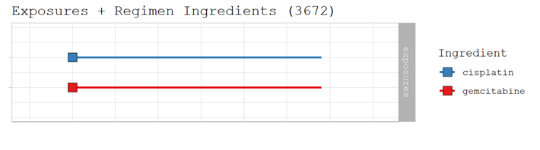
Example 1
Graphical representation

Slide 43
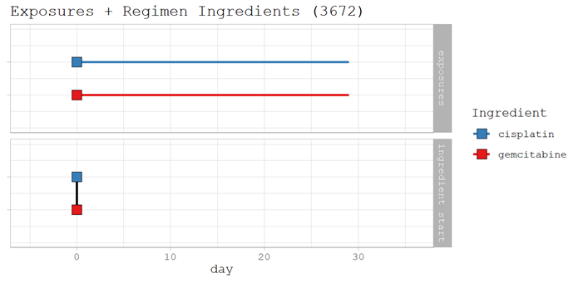
Example 1
Graphical representation

Slide 44
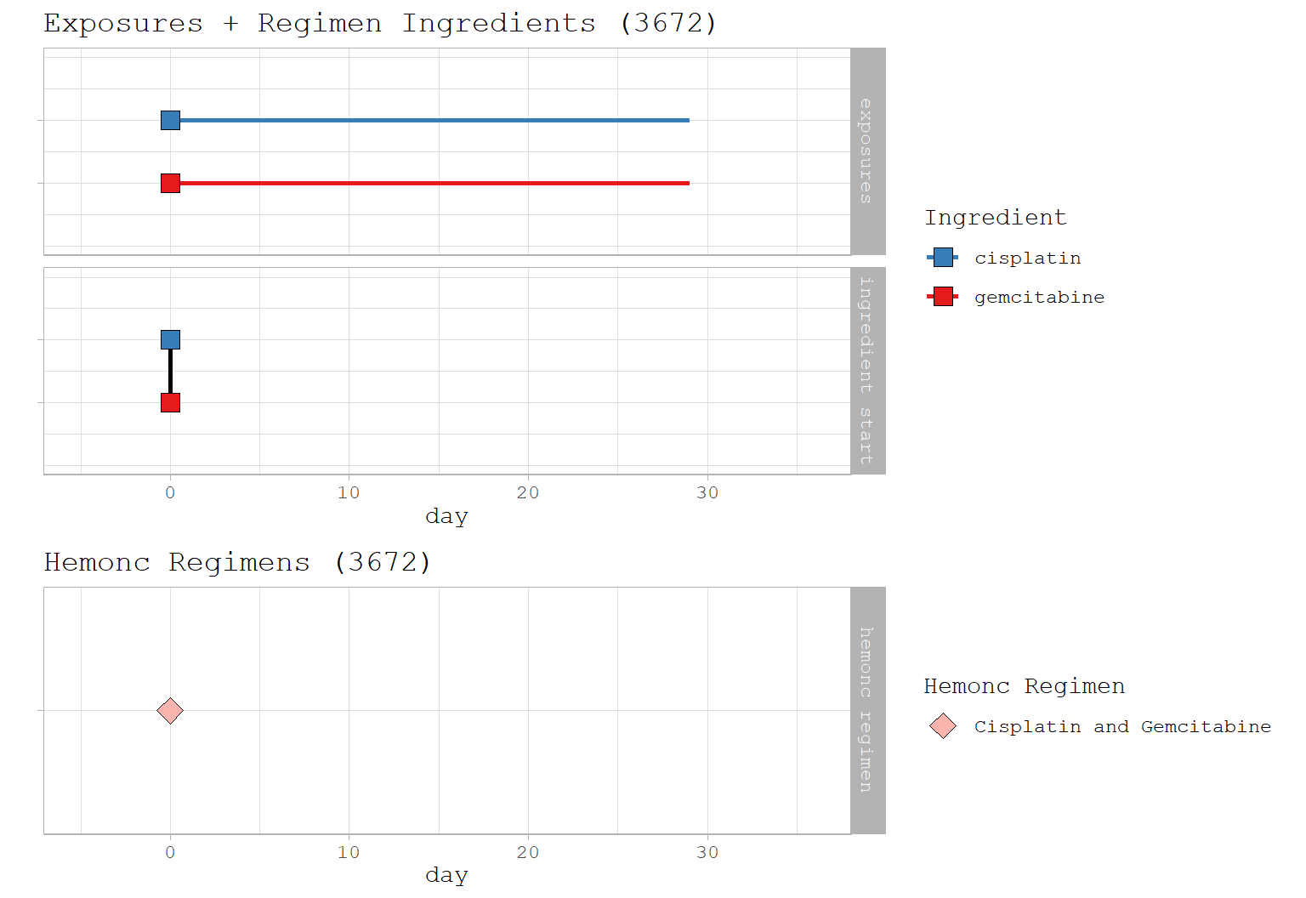
Example 1
Graphical representation

Slide 45
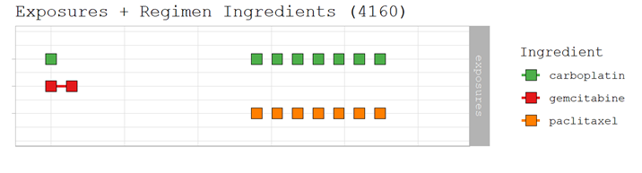
Example 2
Graphical representation

Slide 46
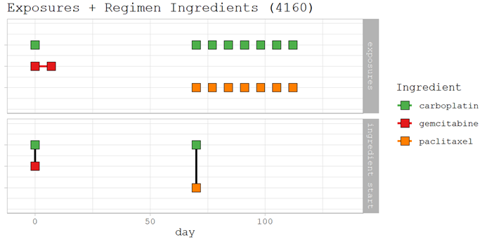
Example 2
Graphical representation

Slide 47
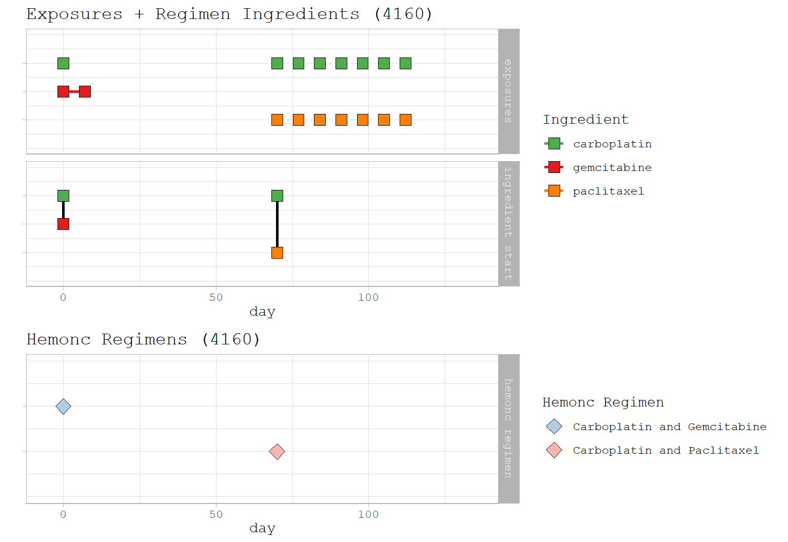
Example 2
Graphical representation

Slide 48
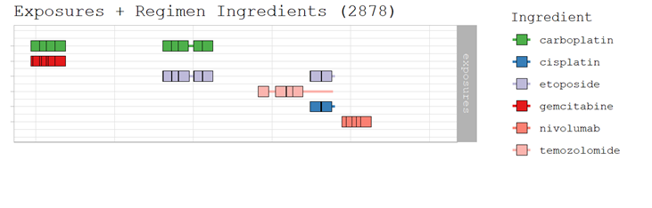
Example 3
Graphical representation

Slide 49
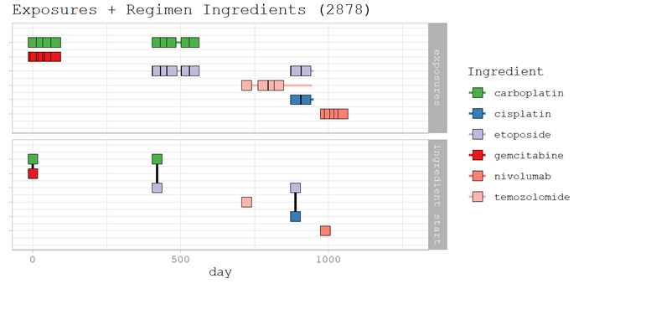
Example 3
Graphical representation

Slide 50
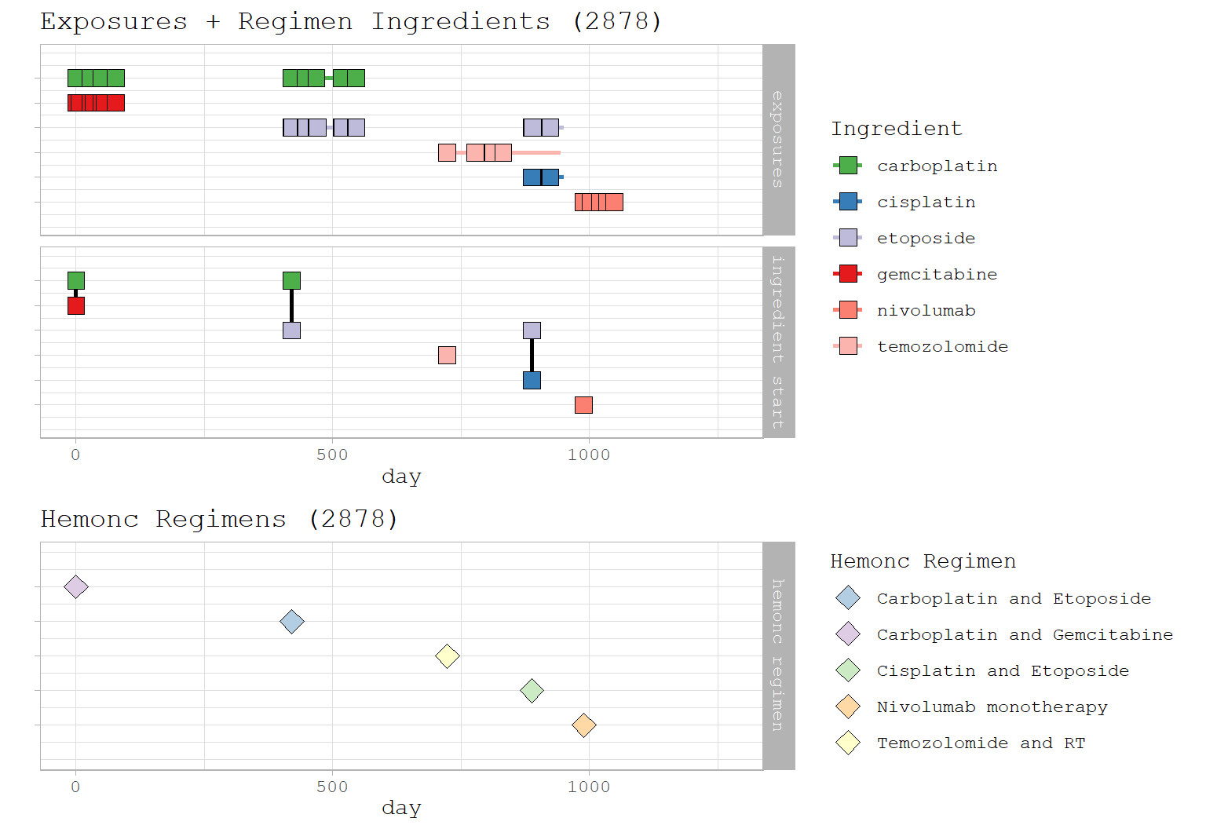
Example 3
Graphical representation

Slide 51
Summary
Chemotherapy is complex
The regimen package and the HemOnc vocabulary are used
Regimens and cycles go into the Episode table
This is the first version
Cannot do dosing or alternating timing of dosing/ingredients

Slide 52
Thank you !!
Anastasios Siapos anastasios.siapos@iqvia.com
Christian Reich christian.reich@iqvia.com
Sarah Seager sarah.seager@iqvia.com
Henry Morgan Stewart hmorganstewart@uk.imshealth.com

